Slide 1

BUSINESS DEVELOPMENT
New Funding ─ New Product
Notes:
Business Development falls under our Partnership Marketing division at VTC

Slide 2



TDFP
TZONE
TID
Notes:
Today, I’ll be speaking on (3) key areas:
TDFP Tourism Development Financing Program
TZone Tourism Zones
TID Tourism Improvement Districts

Slide 3
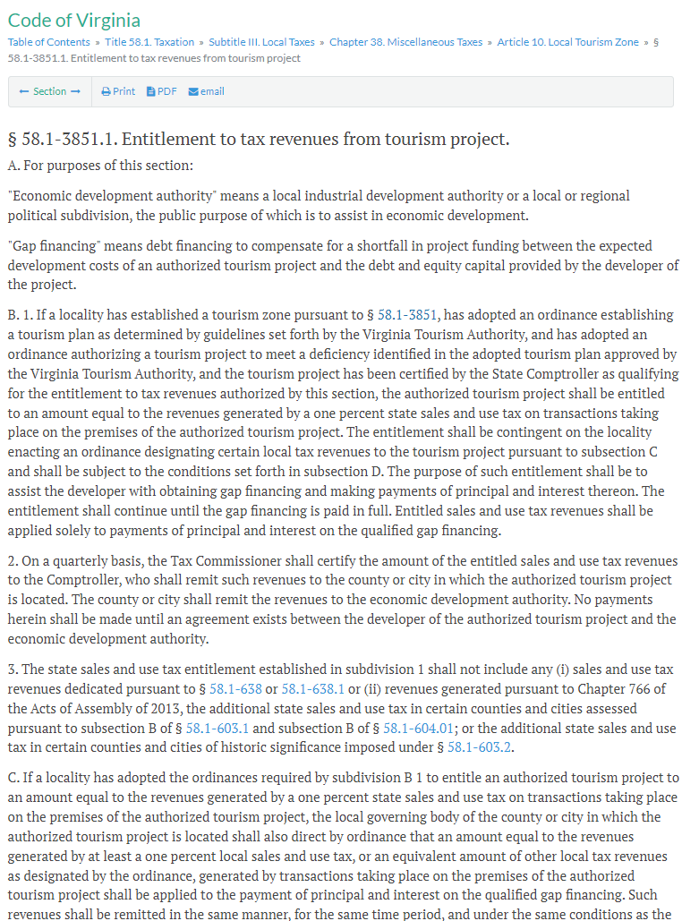

Notes:
The TDFP │ Tourism Development Financing Program was created and written into VA Code in 2011 by the General Assembly
It’s main purpose to support filling deficiencies in tourism product (mainly lodging) where visitor demand is high
To identify where product development is needed and to support the funding for these key, larger-scale projects
> click to fade-in next image on this slide > “Tourism Development in ACTION”
Rather than read the code together (quite daunting ☺ ) let’s look at the exciting results that TDFP has brought to VA
From 2011 to 2024 …
* Read projects and results on the graphic

Slide 4

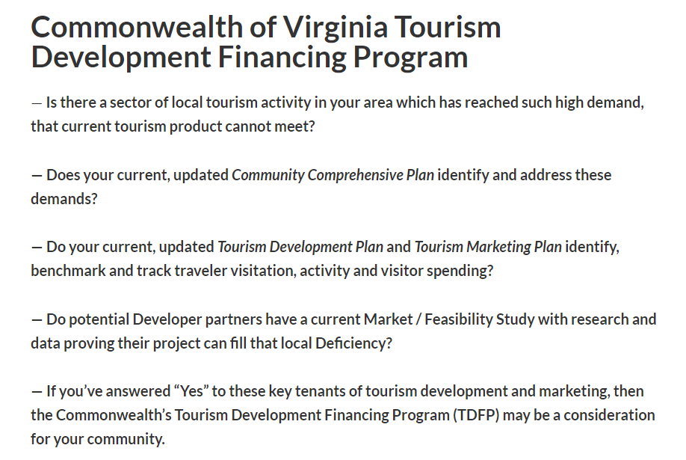


✔ Areas with High
Visitor Demand
X Areas with Med
Visitor Demand
X Areas with Low
Visitor Demand
Notes:
TDFP is not for project development with low or med visitor demand
It is specifically for area that trough data and research prove a high visitor demand
With TDFP, the local EDA is the applicant
They contact VTC to prove with data they have a visitor demand for new lodging
Their Developer partner an build a property filling that deficiency
And produce a current market study proving their project fills the deficiency
> Continue to click to fade-in next highlight of the slide
— Is there a sector of local tourism activity in your area which has reached such high demand, that current tourism product cannot meet?
— Does your current, updated Community Comprehensive Plan identify and address these demands?
— Do your current, updated Tourism Development Plan and Tourism Marketing Plan identify, benchmark and track traveler visitation, activity and visitor spending?
— Do potential Developer partners have a current Market / Feasibility Study with research and data proving their project can fill that local Deficiency?
— If you’ve answered “Yes” to these key tenants of tourism development and
marketing, then the Commonwealth’s Tourism Development Financing Program (TDFP) may be a consideration for your community

Slide 5

Notes:
Consider the different types of lodging: small boutique, larger urban mainstream hotel brands, university-connect lodging and resort lodging
Different lodging types serving different types of recreational, business, group and sports team visitors

Slide 6

?
30%
70%
Notes:
How does TDFP Gap Financing support work?

Slide 7
TDFP Definition + Scope
⎯ Supports a Developer’s gap financing
⎯ Much like a Tax Rebate or Tax Increment Financing ‒ contribute future sales tax revenues towards Developer’s project
X Not an upfront incentive
X Not a grant
X Not for renovations to operating businesses
X Not for projects already under constructinon
⎯ Developer secures 100% of the financing in advance to complete the project
⎯ Performance Based ‒ State and County contributions begin when project is generating revenue
⎯ Project Focused ‒ Does not include surrounding businesses or industries
⎯ Low Liability ‒ If the project ceases revenue generation for any reason, neither State nor County contribute further

Slide 8

1
2
3
< $100 m
> $100 m
> $500 m
$ 112 k = Year Gap Payment
$ 180 k = Year Gap Payment
$ 240 k = Year Gap Payment
$ 30 k = Dev + Local + State
$ 45 k = Dev + Local + State
$ 60 k = Dev + Local + State
1% —
$ 10 k = Qty. Revenue
1.5% —
$ 15 k = Qty. Revenue
2% —
$ 20 k = Qty. Revenue
$ 1 m = Qty. Revenue
$ 1 m = Qty. Revenue
$ 1 m = Qty. Revenue
30%
20%
30%
Lender
Gap
Gap
Gap
Lender
Lender
80%
70%
70%
Developer
Equity + Debt
Developer
Equity + Debt
Developer
Equity + Debt
Notes:
You’ll notice (3) Tiers of TDFP Support:
Teir 1 – for projects under $100M
Developer has 70% of funding secured through debt & equity
Finds Lender for missing 30% Gap and completes the project
Once open and generating revenue, collects new revenue and sales tax
Quarterly, EDA works with VA Tax to identify amount of Quarterly Revenue
An amount equal to 1% of Quarterly Revenue is the amount all three partners pay to the Lender toward Gap Loan Debt Service (Developer – Locality – State)
Quarterly payments to the Lender continue until the life of the gap debt is services
Teir 2 – for projects $100M and over
Developer has 80% of funding secured through debt & equity
Finds Lender for missing 20% Gap and completes the project
An amount equal to 1.5% of Quarterly Revenue is the amount all three partners pay
Teir 3 – for projects over $500M
Developer has 70% of funding secured through debt & equity
Finds Lender for missing 20% Gap and completes the project
An amount equal to 2% of Quarterly Revenue is the amount all three partners pay

Slide 9
1
< $100 m
TDFP BENEFITS
⎯ But for TDFP … the project halts
⎯ Developer secures 100% of the financing
⎯ New Product Development
⎯ Net New Construction (not renovation)
⎯ Net New Jobs
⎯ Low Liability … No revenue? State & Locality stops $
⎯ Hub & Spoke Multiplier … Visitor Spending to other local businesses
⎯ Potential new TID partner
$ 112 k = Year Gap Payment
$ 30 k = Dev + Local + State
1% —
$ 10 k = Qty. Revenue
$ 1 m = Qty. Revenue
30%
Gap
Lender
70%
Developer
Equity + Debt

Slide 10
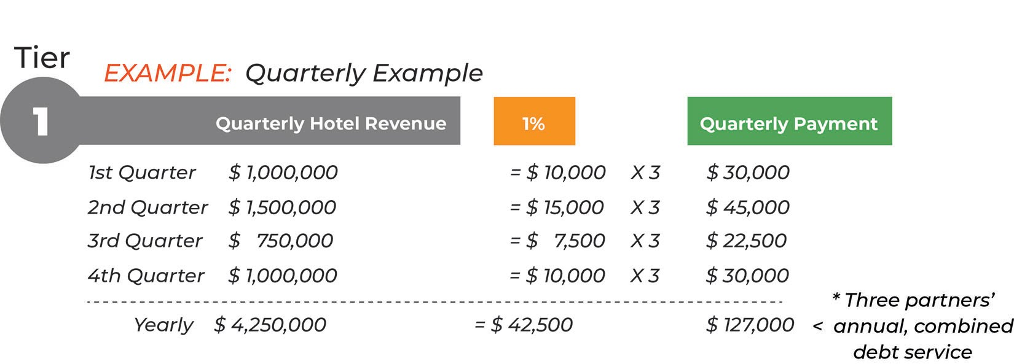
TDFP Example of Quarterly Payments

Slide 11
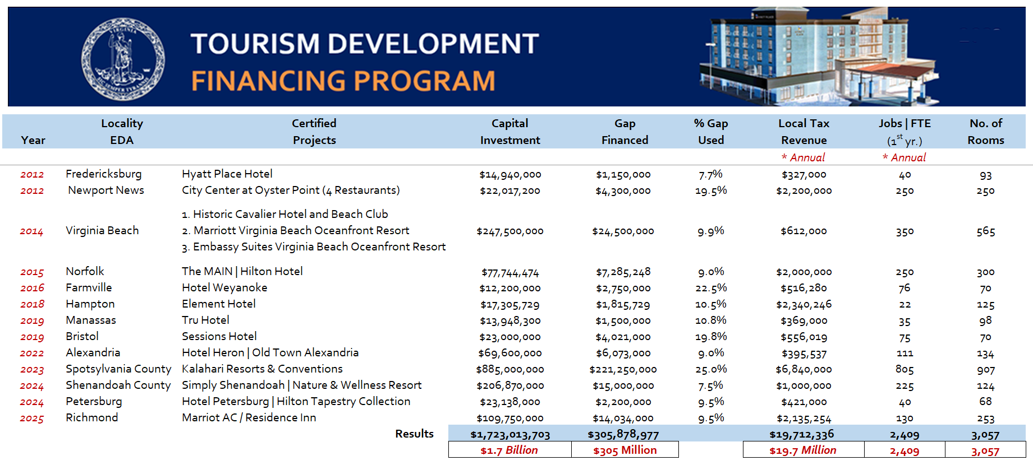
TDFP TDFP │ Certified Projects

Slide 12

70%
100% Financing
Prove Deficiency
Local Comprehensive Plan
Tourism Development Plan
Tourism Marketing Plan
Current Developer Market Study
Tourism Zone
Much like a
Tax Rebate
Or TIF
Tax Increment Financing
Municipality and State divert and contribute future sales tax revenues towards the Developer’s debt with the Lender

Slide 13
TZONE

Slide 14
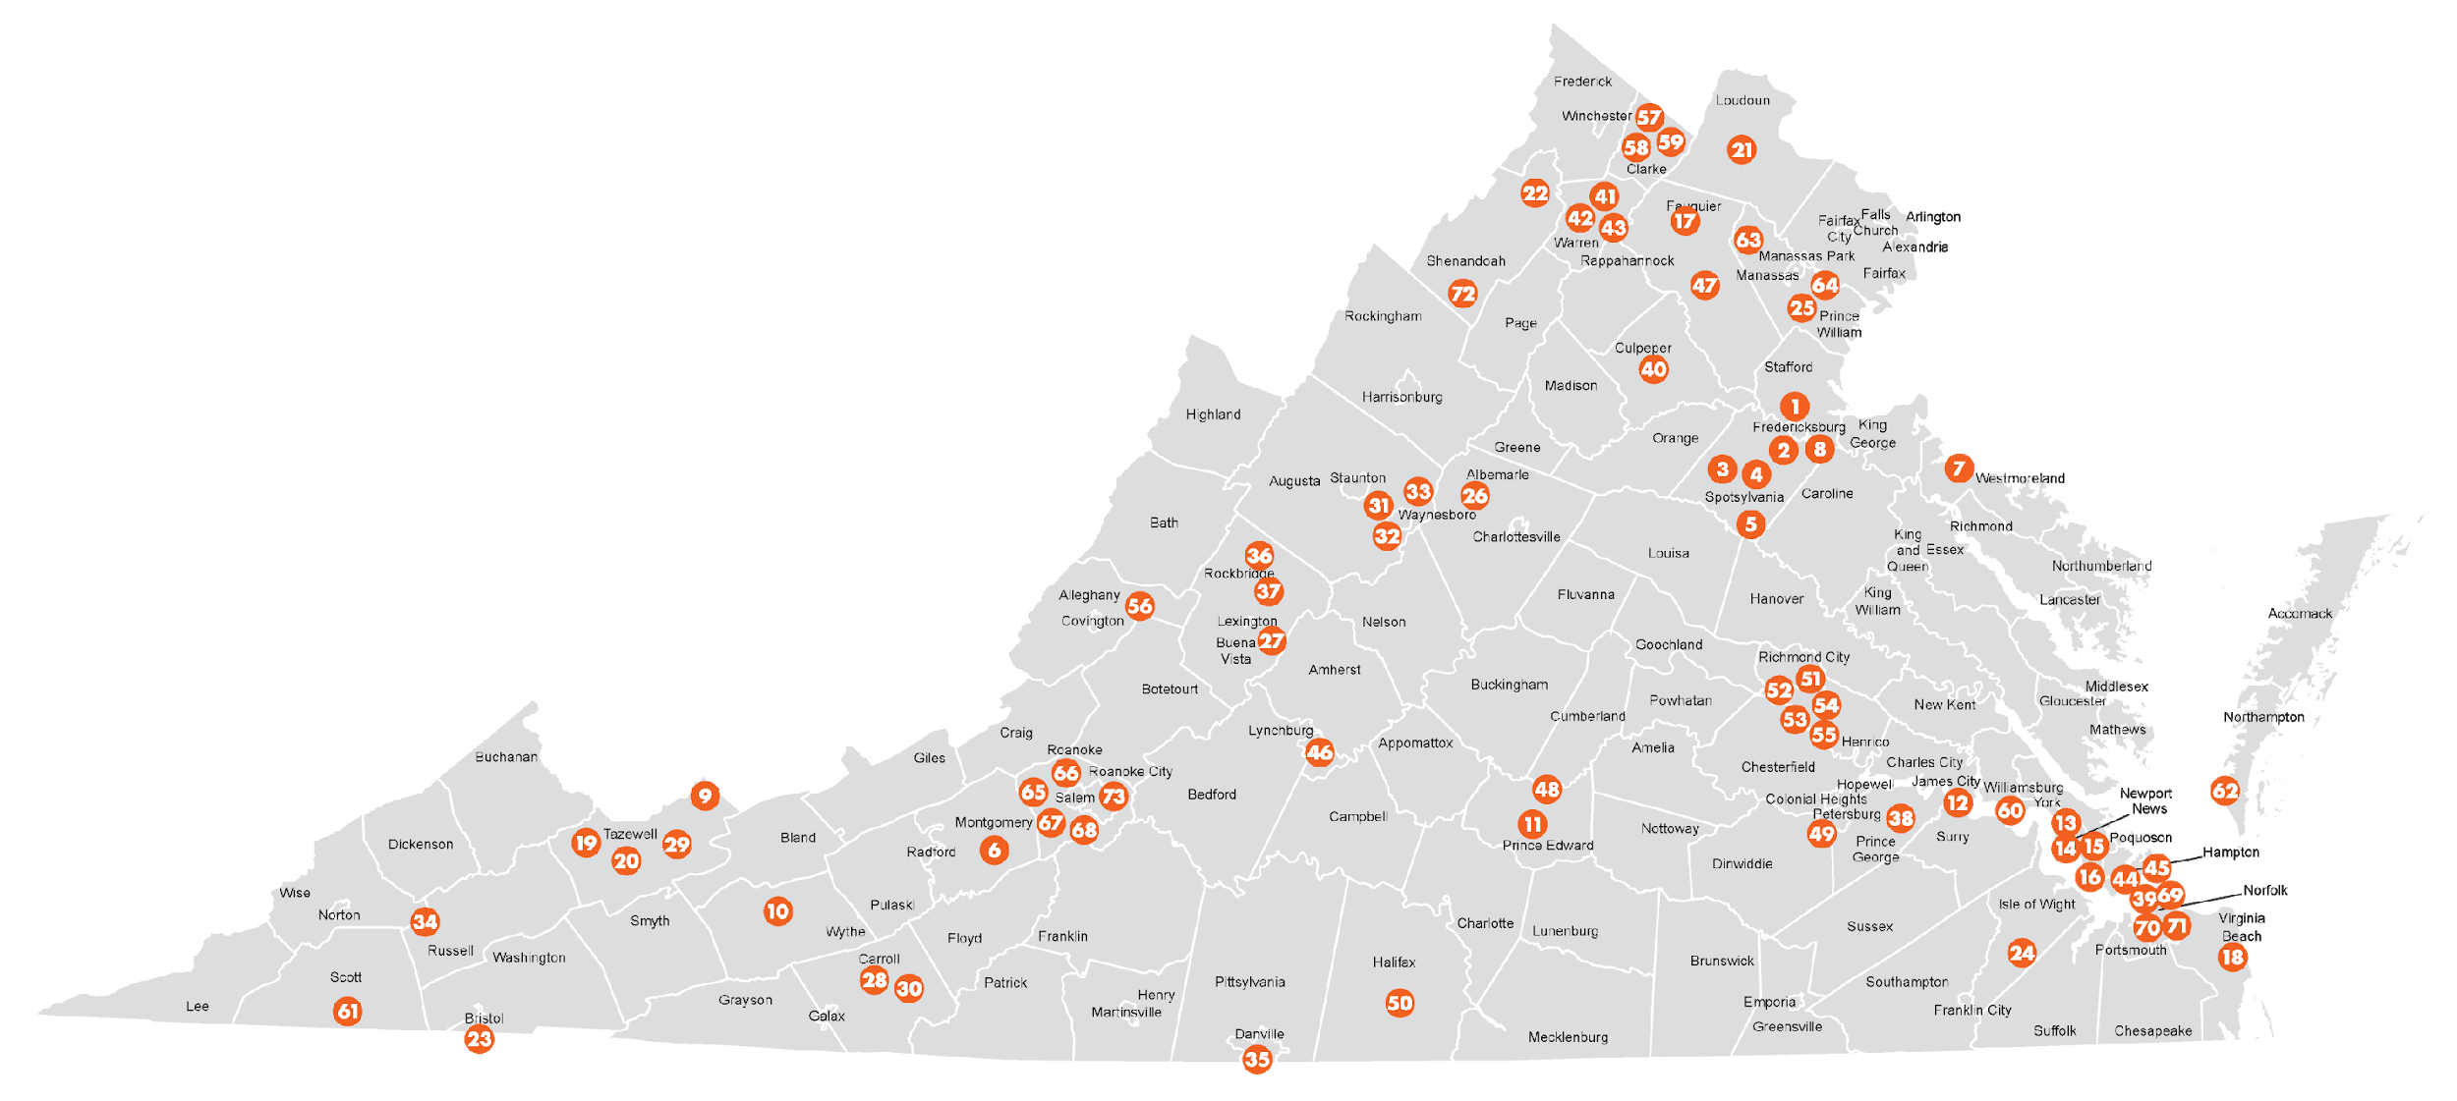
Tourism Zones in Virginia
VATC.org/tourismzones
Notes:
I’m going to change gears here for a minute and talk zoning
First, Tourism Zones which area great tool for furthering tourism development in your community
Separate from TDFP, these zones help incentivize existing tourism businesses in a community – e.g. lodging, dining, retail, attractions, outdoors, experiences
Without any State management, a Locality can create their own zone and subsequent incentives for businesses that meet locality-specified revenue, tax revenue and job thresholds
These incentive can be changed to increase benefits to recruit new business

Slide 15
Notes:
A locality can create several different Tourism Zones to accommodate different areas travelers visit and spend the most

Slide 16
Notes:
Or create one zone for the entire area, which includes and incentivizes all tourism business in the area

Slide 17
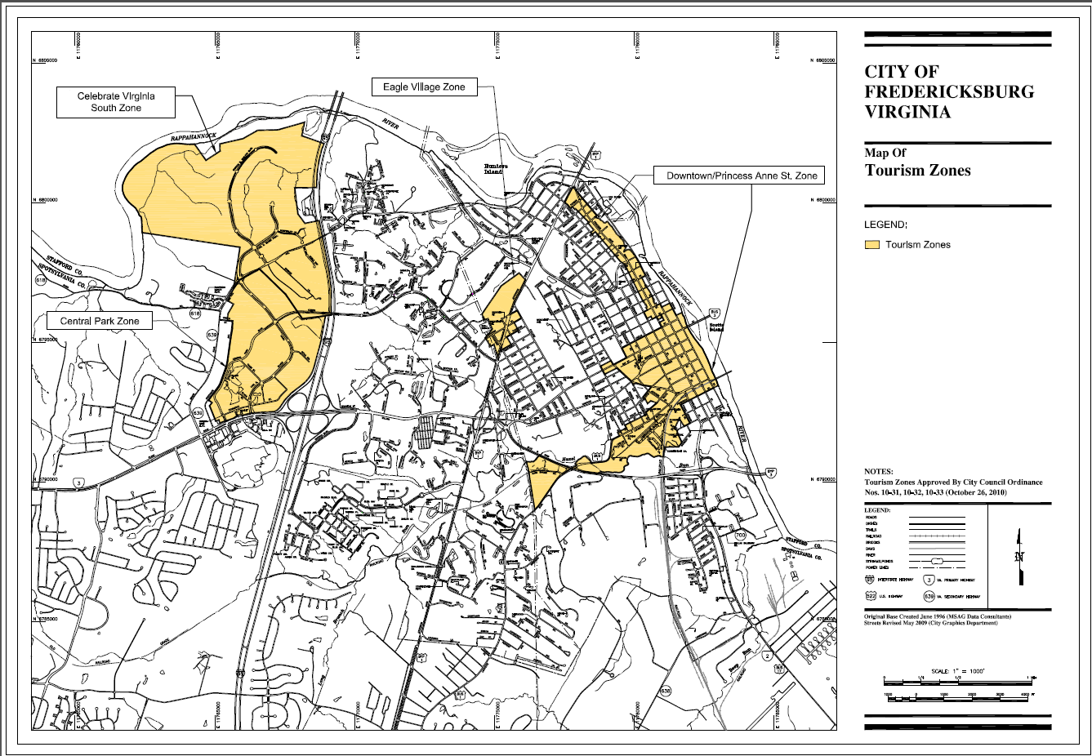
Notes:
Fredericksburg is a great example of a community who has fully taken advantage of tourism zones
They have 3 zones, all targeting different types of development

Slide 18
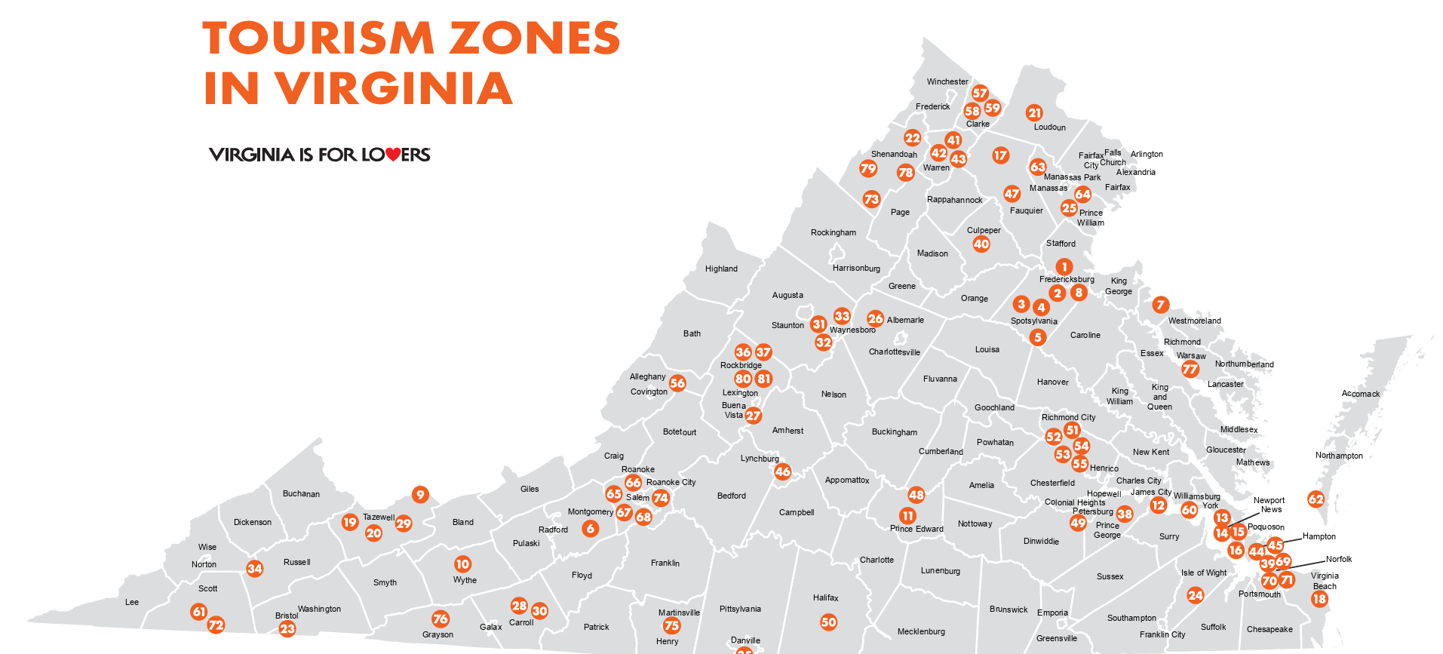
VATC.org/tourismzones
Notes:
Visit www.VATC.org/tourismzones find and click to expand on the map of Tourism Zones in Virginia

Slide 19
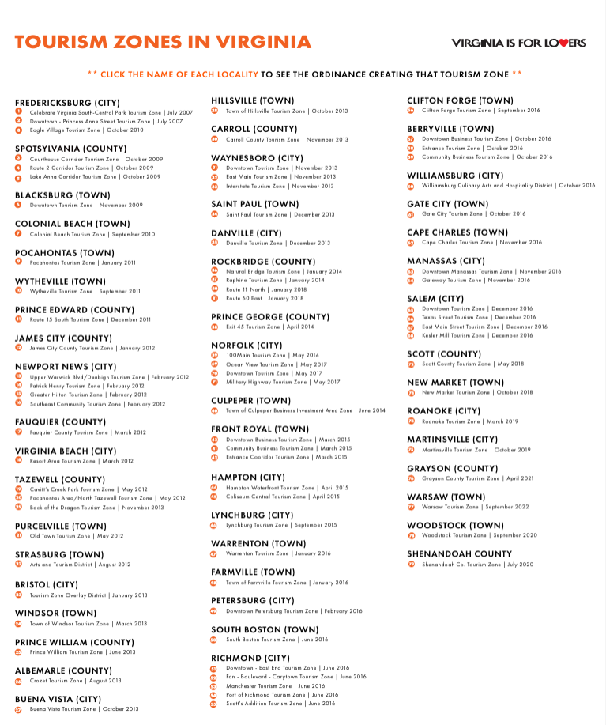
VATC.org/tourismzones

Slide 20
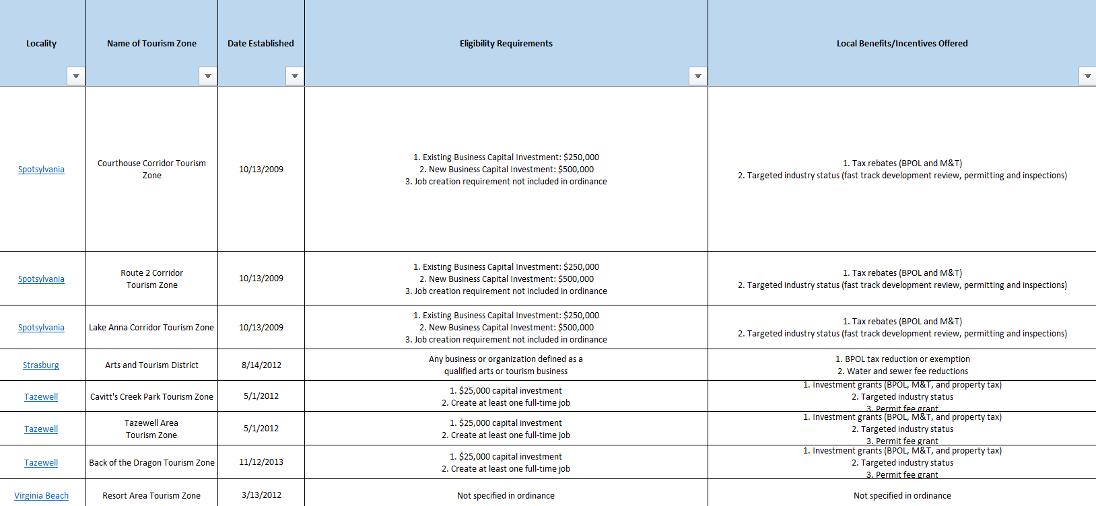
VATC.org/tourismzones
Notes:
Visit www.VATC.org/tourismzones also find, click and expand a ‘Matrix’ spreadsheet which lists:
1. The name of each zone * click to see local Ordinance the Tourism Zone
2 The name of each zone
The Date Established
The Eligibility Requirements of local tourism businesses to receive zone incentives
The following columns the local incentives the zone may award

Slide 21
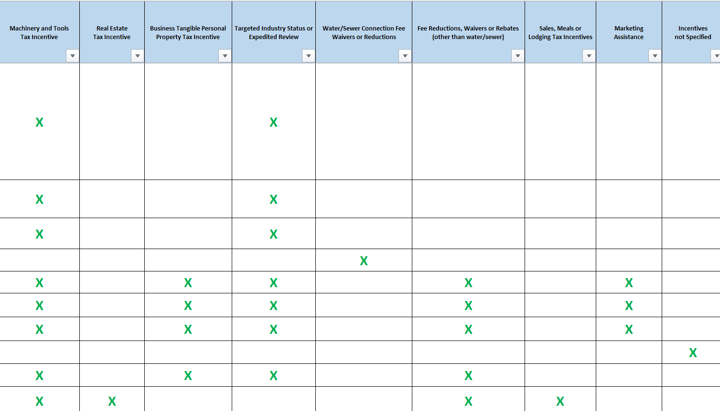
VATC.org/tourismzones
Notes:
Visit www.VATC.org/tourismzones also find, click and expand a ‘Matrix’ spreadsheet which lists:
1. The name of each zone * click to see local Ordinance the Tourism Zone
2 The name of each zone
The Date Established
The Eligibility Requirements of local tourism businesses to receive zone incentives
The following columns the local incentives the zone may award

Slide 22
TID
Notes:
I’m now going to speak about Tourism Improvement Districts

Slide 23
Tourism Improvement Districts
A business district created to increase revenue
for destination marketing & capital investment
Tourism businesses collect new visitor fees to
fund local tourism marketing & development
Notes:
These are new to Virginia as of 2022

Slide 24

Notes:
While the founding partners / participants are usually hotels, local dining, retail and attractions can collect the visitor fee right for the scale of their business, and contribute

Slide 25
Notes:
Usually created by lodging partners with steady, year-long overnight spending, a Zone is created when lodging partners petition to collect a new ‘Visitor Fee’ (different than a tax)
This fee is collected and combined to fund new marketing, capital improvements and more for the areas the lodging partners are located
And, usually, community lodging partners identify those hotels with 70+ rooms to participate (green circles) and smaller lodging partners decline to participate (dark circles)

Slide 26
Notes:
A TID can be one, large are comprised of all those type of businesses aforementioned

Slide 27

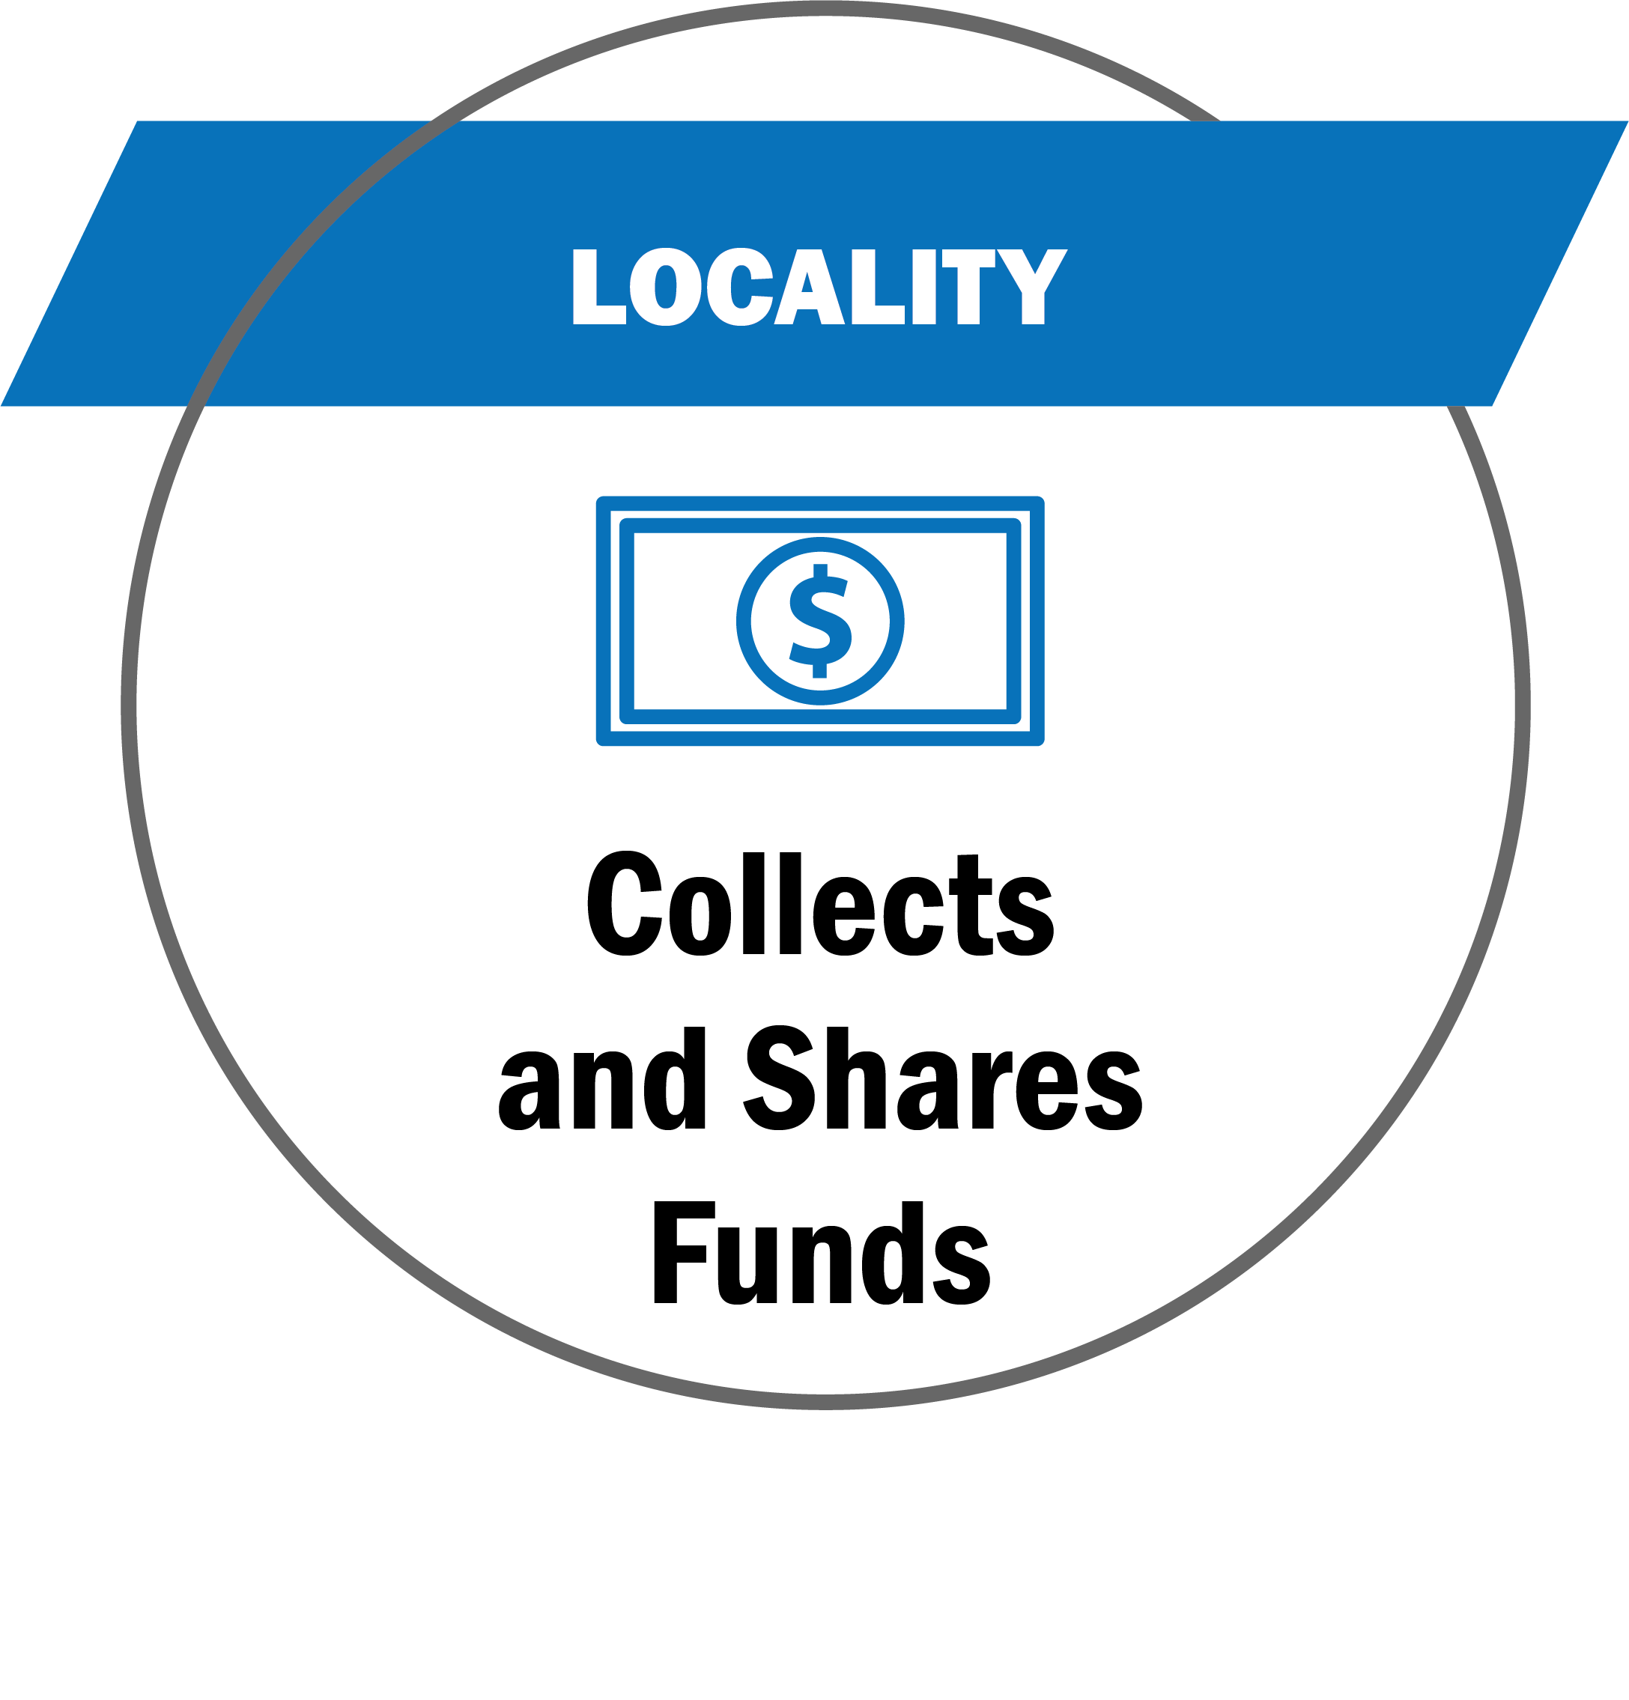
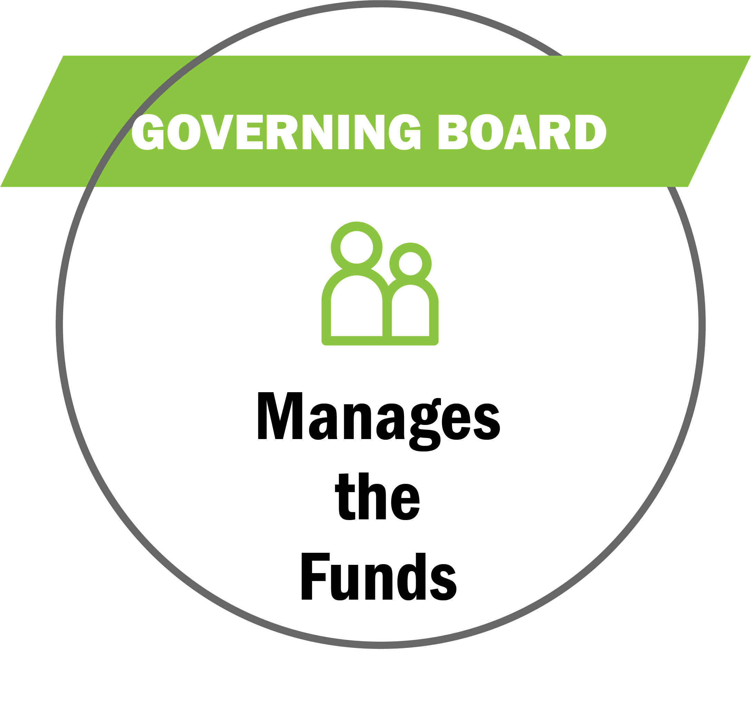
Benefited Businesses
Tourism Businesses
Initiates TID interest
Identify boundaries
Creates plan for $
Petition locality to collect $
Locality
Municipality containing TID
Public hearing review
Approves petition
Collects fees > TID
Governing Board
Governing Board over TID Plan
Directs the funds
Executes the plan
Oversees any changes

Slide 28
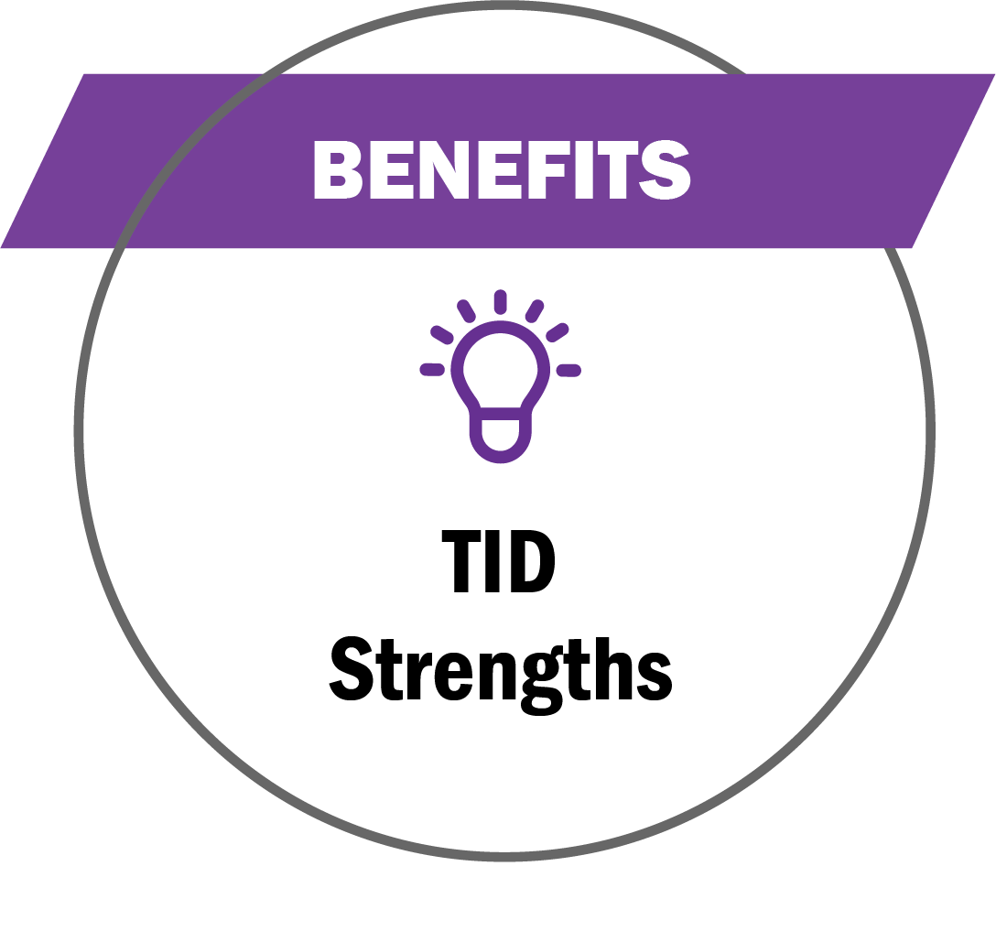
Grow & Leverage Tourism Funding
Stable and fixed funding sources for marketing efforts
Industry-led and privately managed and approved by stakeholders
Existing funding protected and new funding stays with the industry
Designed to increase longer stays and more visitor spending
Accountability and transparency
Mitigate the harsh impacts COVID-19

Slide 29

Fund Usage
Marketing, capital improvements, programming, workforce and training
Sales site visits and events, group meeting incentives and bid fees, group commissions and rebates
Pay expenses to the Administering Nonprofit associated with the TID management and efforts

Slide 30
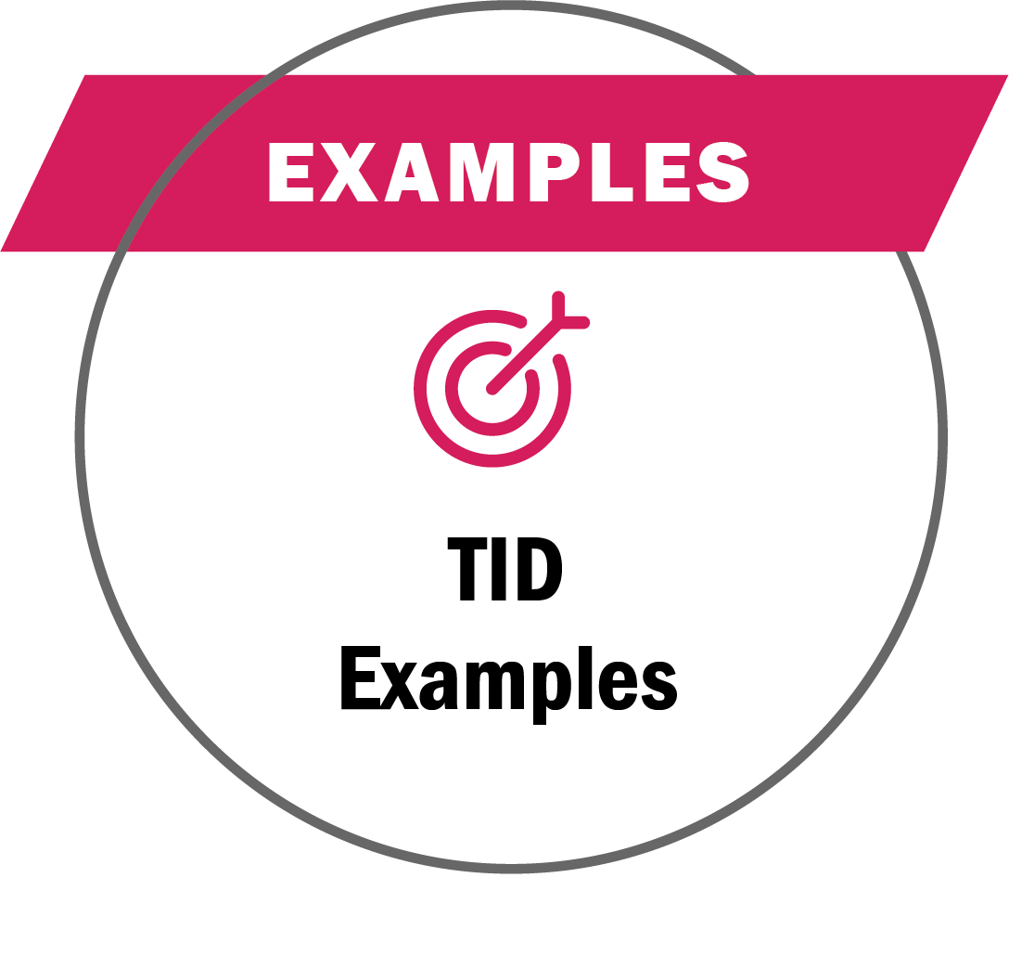


Benefited Businesses
Funding Examples
Lodging 70+ rooms add 2% room/night fee
Eligible = advertising costs, agency fees, production, printing, distribution costs, training, travel, printed material, promotional items, information technology, market intelligence, research, & performance audits
Benefited Businesses
Funding Results
.75% on room daily rate
Achieved ROI of 8:1 for funds allocated
$5.6 Million collected in their first year
92 Large conventions & events funded
Resulted in $1.6 Billion in economic impact

Slide 31
TID Zone
Town – City
County
TID Zone
Counties
Region
* Most commonly
Lodging, which creates
the maximum, substantial
volume and revenue
County A
County B
Lodging
Dining
Retail
Attractions
Wineries
Distilleries
Cideries
Breweries
Meaderies
Notes:
To recap …
A locality can have 1 Zone ⏐ Different Businesses Contribute
TIDs are primarily created with lodging/hotels as the lead partners
They have the visitor spending levels and frequency to establish and collect new visitor fees
Other tourism business sectors such as dining, retail and attractions can contribute if the local business community is unified , but this is rare
A locality can have 1 Zone ⏐ Specific Businesses Contribute Across Jurisdicitons
Businesses representing specific business sectors can collaborate and petition for a TID
A TID plan with only lodging, wineries, distilleries, cideries; or, restaurants or certain types of attractions can be created
Those benefiting businesses would collaborate, create their TID zone boundaries and plan
Then, petition the local government to adopt and pass the TID plan (as with the example above)

Slide 32

Zone
Town
City
County
Richmond City * managing non-profit
Ashland Town
Chesterfield Counties
Hanover
Henrico
Lodging
The Richmond Region recently approved a new Tourism Improvement District (TID). The TID is expected to generate as much as $8.2 million annually to support the promotion of the region as a leisure, conference and sports tourism destination.
Notes:
Richmond Region Tourism is the first, and currently only, TID in Virginia
It is comprised of the current, regional tourism partners
Each locality passed local ordinances agreeing to participate in the TID, and to collect the funds to give to the TID Governing Body
The funds are then used regionally
Visit https://www.visitrichmondva.com/tid/ to learn more and sea their annual success report

Slide 33
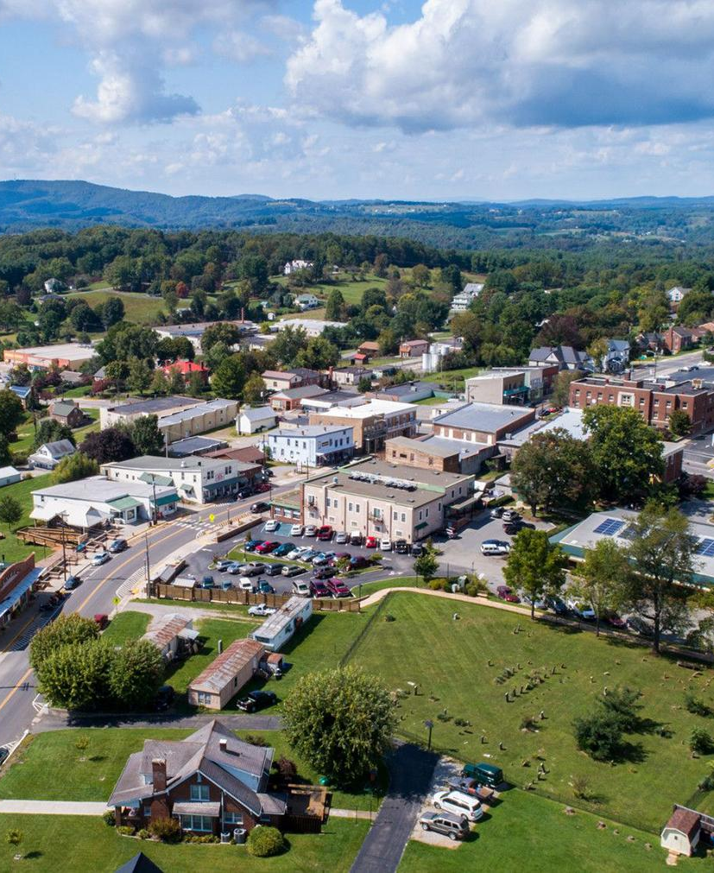

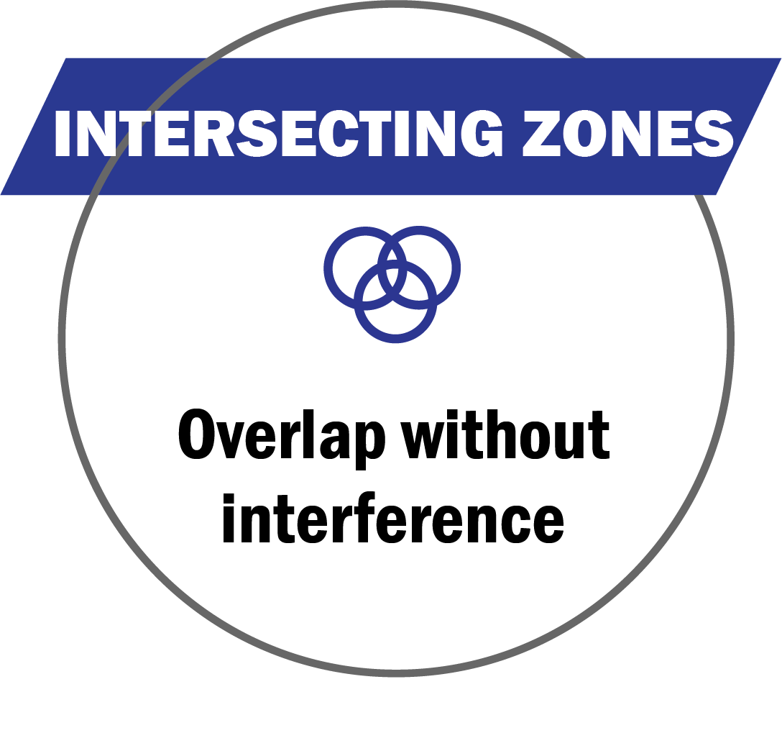



* Zones can overlap, but do not share any program
mandates, legal or funding requirements, or benefits
Tourism
Zone
Opportunity
Zone
VATC.org/tourismzones
DHCD.virginia.gov/opportunity-zones-oz
Tourism
Improvement
District
https://civitasadvisors.com/resources/research/tourism-improvement-district
15
Notes:
Tourism Zones can overlap with Virginia Opportunity Zones and other business zones, and do not share zone requirements and mandates
This includes the TIDs (Tourism Improvement Districts)
The newest of Virginia's tourism-related zone opportunities, TIDs authorize any a locality to create a local tourism improvement district plan, consisting of fees charged to visitors and used to fund tourism promotion activities and capital improvements
All TID funded initiatives follow the a plan, created by TID Governing Board, whose members are benefiting businesses
Visit > CIVITAS Advisor’s TIDs webpage for a deeper dive into TIDs and contact Tiffany Gallagher tgallagher@civitasadvisors.com

Slide 34

CONTACT
Wirt Confroy
Director of Business Development
wconfroy@virginia.org
(804) 545-5552
16

