Slide 1

VTC
Spring 2026
VA250 Tourism Marketing
Grant Program
VTC Grants Presentation – May 2026
Notes:
Hi everyone. My name is Staci Martin and I am VTC’s Partnership Marketing Grants Director. Our team manages five different funding programs one of which is open twice per year giving us six total rounds per year. Our funding for grants does depend on our general assembly allocation and is backed by some legislation. That said, before I get into our grant programs I want to give a quick overview on why we offer these grant programs and how they layer together with statewide, nationwide, and international marketing and with tourism development.

Slide 2
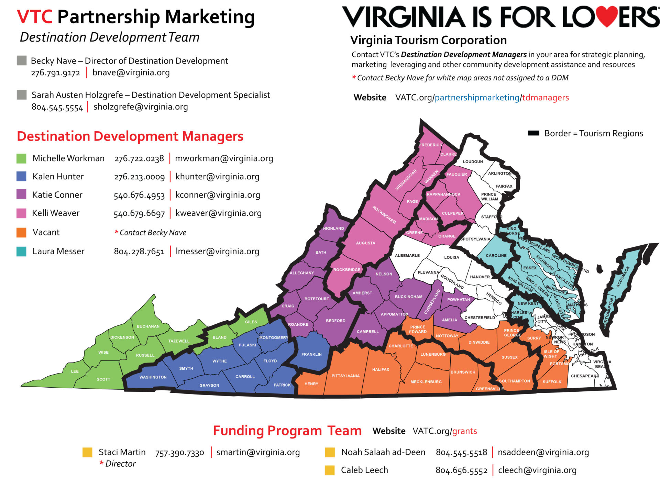

VTC’S DEVELOPMENT & FUNDING PROGRAM TEAM
Focused in rural strategic growth areas
Embedded in their respective regions
Funding programs are open to all regions, even if there is no Destination Development Specialist
Focus on tourism product development, entrepreneurial development, locality tourism action planning, and advocacy
Funding team manages five different grant and funding programs; allocations tracked by Go Virginia region

Slide 3
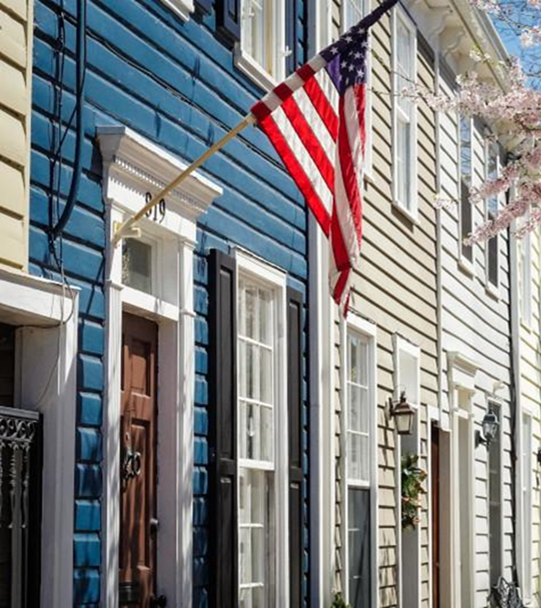
Open until Thursday, May 28, 2026
VA250 Tourism Marketing Program
$10,000 MAXIMUM AWARD
MARKETING PROGRAMS & DESTINATIONS
CONNECTING TO ANY PERIOD OF AMERICAN HISTORY & CULTURE
SPECIAL ROUND SPRING 2026
OPEN TO VA250 LOCAL COMMITTEES, HISTORIC SITES, AND MUSEUMS.
DMOs MAY APPLY IF ACTING ON BEHALF OF THEIR LOCAL VA250 COMMITTEE OR IF THEY ARE THE DESIGNATED VA250 COMMITTEE

Slide 4
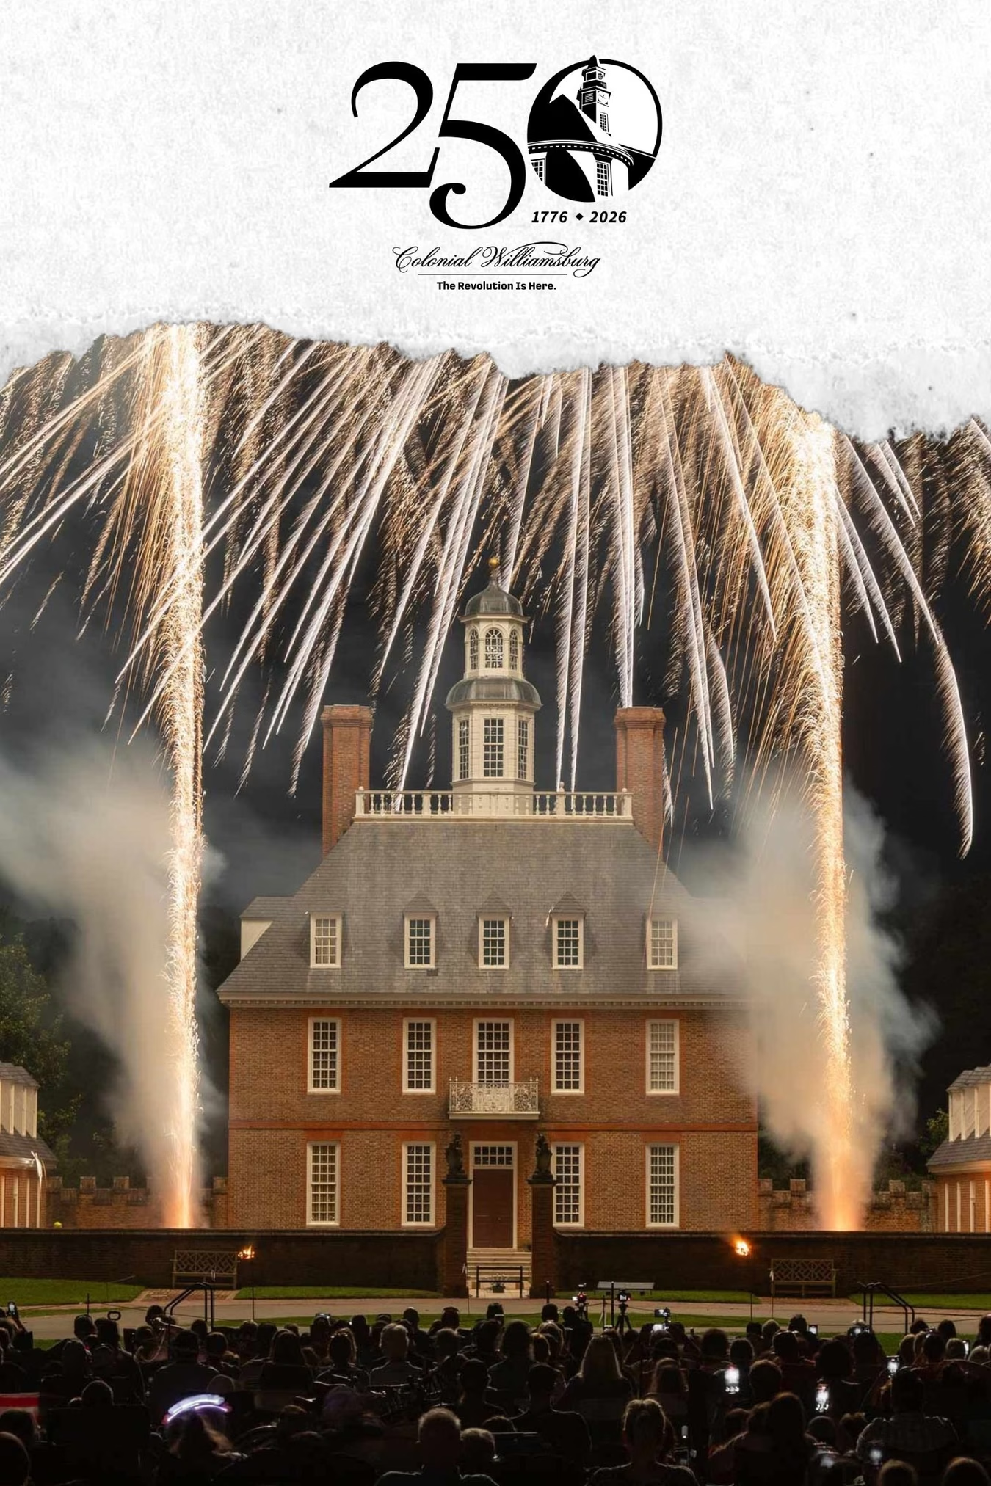

Spring 2026 Grant Round
Apply through online application portal at VATC.org/grants
Application opens Tuesday, May 5, 2026
Application closes Thursday, May 28, 2026
Must include 2 financial partners in your application and a support letter from the local DMO
Focused on promoting and marketing 4th of July activities in your locality and streaming the America Made in Virginia: 250 Years Together simulcast from Colonial Williamsburg.
Applicants may apply for up to $10,000 with a 1:1 cash match required, to be distributed on a reimbursement basis. Economic Development District applicant location qualifies for in-kind match.
Eligible expense include marketing expenses and up to $5000 of the award for A/V services, screens, projectors, and/or chair rentals to livestream the event.

Slide 5
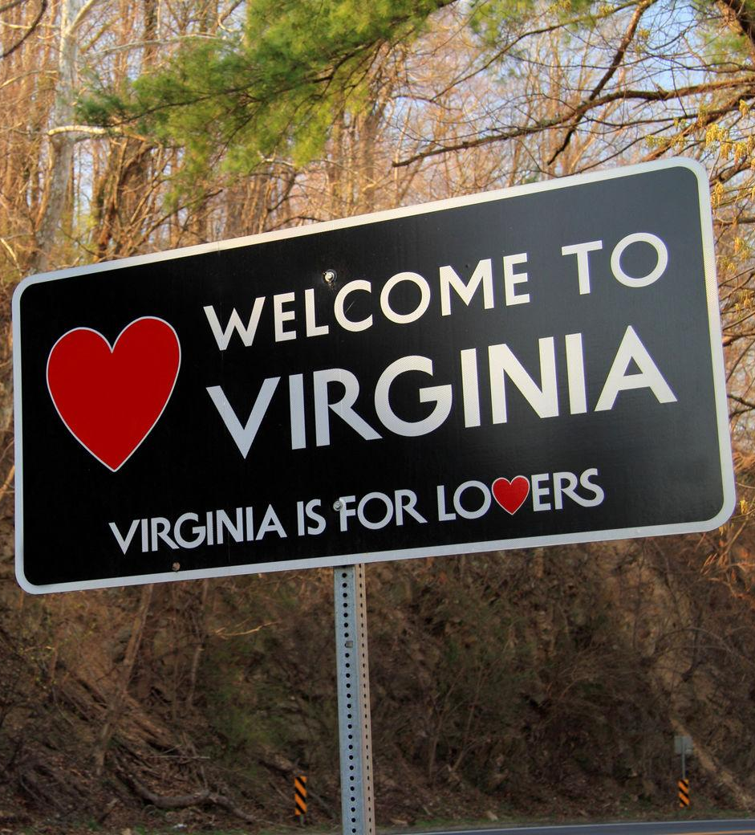
Spring 2026 Grant Round
Tourism marketing expenses remain eligible. However, interpretive signage is not permitted in this round.
Up to 15 BONUS points may be awarded if activating the “America Made in Virginia: 250 Years Together” livestreaming opportunity
Ideas for livestreaming include:
  Livestream before your locality’s 4th of July events in a public area or area where visitor normally congregate to watch fireworks. Turn off the VA250 livestream when you start your local fireworks.
  Livestream the events outdoors on a wall or screen where visitors may be walking to/from your locality’s 4th of July activities.
  Livestream in Visitor Centers that will remain open in the evening hours.
  Encourage your Main Street businesses, restaurants, breweries, wineries and other indoor activity partners to stream the broadcast from 8 p.m. to 10 p.m.
  Create an indoor or outdoor event in a local arena, sportsplex, racetrack, or theater and livestream the broadcast. You could do this against the backdrop of creating a sensory friendly or pet friendly experience with low volume so that folks can enjoy the livestream with closed captions and view the Colonial Williamsburg fireworks.

Slide 6
OVERALL PROGRAM FOCUS:
OVERNIGHT TRAVEL, OUT-OF-REGION TRAVEL, OUT OF STATE VISITORS
Assist Virginia communities in their efforts to commemorate the 250th anniversary, through a tourism lens by creating robust visitor experiences and visitation opportunities
Encouraging and stimulating investment by combined efforts of local, regional, and statewide entities for Virginia 250 cultural marketing initiatives
Marketing Virginia as a year-round travel destination for individuals and groups
Marketing the historical and cultural attractions of Virginia to travelers
Notes:
First of all, all of our programs are focused on driving overnight visitation and out-of-state visitation. For some of our programs, we use an economic impact formula based on projected attendance at events as a factor in the application score. For some of our programs, we can only allocated up to 20% of the total funds available to any single Go Virginia region. So as you work on your grant applications make sure you keep these things in mind. I want to stress again overnight travel is the driver and improves your chances of getting funding. If you have a retail store think about partnering with an outfitter, attraction, and lodging partner so you can get to that minimum two to three night stay.

Slide 7


LET’S WORK TOGETHER!
REACH OUT TO THE DESTINATION DEVELOPMENT TEAM
REACH OUT TO THE GRANTS TEAM
FUNDING PROGRAMS OVERVIEW: VATC.ORG/GRANTS
QUESTIONS?
STACI MARTIN
GRANTS DIRECTOR
SMARTIN@VIRGINIA.ORG
(757) 390-7330

